Slide 1
  Chapter 14
  Ecommerce, Databases, and Data Science

Slide 2
Learning Objectives (1 of 2)
Explain the issues, pros, and cons of whether to create an ecommerce website.
List the components of online transactions, and explain what is involved in each step.
List one other ecommerce model besides the online retailer selling to the general public and explain how it works.
List one other electronic payment system besides traditional credit cards and explain how it works.
零售商
Notes:
说明是否创建电子商务网站的问题，利弊。
列出在线交易的组成部分，并解释每个步骤所涉及的内容。
列出除向大众销售的在线零售商以外的另一种电子商务模式，并说明其工作方式。
列出除传统信用卡之外的另一种电子支付系统，并说明其工作方式。

Slide 3
Learning Objectives (2 of 2)
Describe the relational database model
Frame simple queries in SQL to retrieve information from one or more tables in a relational database
Define data mining
List three sources data brokers use to collect data on individuals
Give an example of data science used "for the greater good"
Notes:
描述关系数据库模型
在SQL中构造简单查询以从关系数据库中的一个或多个表中检索信息
定义数据挖掘
列出数据经纪人用来收集个人数据的三个来源
举例说明“为了更大的利益”而使用的数据科学

Slide 4
Introduction
The World Wide Web enables businesses to communicate with customers through:
  Advertising
  Follow-up support
  Sales to consumers
  Sales to other businesses
  Non-sales transactions (statements and bill pay)
Notes:
万维网使企业可以通过以下方式与客户进行通信：
广告
后续支持
对消费者的销售
对其他企业的销售
非销售交易（报表和账单支付）

Slide 5
Ecommerce (1 of 16)
Ecommerce: business conducted with the Internet and via the web including sales, advertising, and bill pay options
Setting up an organization for ecommerce can be as intensive as setting up a physical store front.
What business problem are you solving?
  Broadening the customer base
  Recapturing customers lost to online competitors
  Serving existing customers better
  Integrating departments of existing business
Notes:
电子商务：通过互联网和网络进行的商业管理，包括销售，广告和账单支付选项
建立电子商务组织与建立实体店面一样耗时。
您正在解决什么业务问题？
扩大客户群
抓住失去在线竞争对手的客户
更好地服务现有客户
现有业务整合部门

Slide 6
Ecommerce (2 of 16)
Risks of moving online
  Same customers moving from in-store to online
  Facing new competition online
  Existing customers don’t need/want online store
  Employee concerns
Costs of moving online
  Computer equipment and infrastructure
  Hiring personnel to manage the website
  Legal expertise required to protect your intellectual property, regulations online, and customer privacy
Notes:
上网的风险
相同的客户从店内转移到在线
面对在线新竞争
现有客户不需要/想要在线商店
员工担忧
上网费用
计算机设备和基础设施
招聘人员管理网站
保护您的知识产权，在线法规和客户隐私所需的法律专业知识

Slide 7
Ecommerce (3 of 16)
Ecommerce decisions:
  Design website in-house or hire an ASP (Application Service Provider)
  Buy or lease equipment
  Use existing software or have custom software written
Notes:
电子商务决策：
内部设计网站或租用ASP（应用服务提供商）
购买或租赁设备
使用现有软件或编写自定义软件

Slide 8
Ecommerce (4 of 16)
Customer transaction overview
  Customer learns of your site and goes there
  Identify return customers and personalize the site
  Provide a secure environment for making purchase
  Process the payment
  Communicate with accounting and credit company
Order fulfillment
  Update inventory
  Contact shipping system and shipping company
  Arrange pick up and delivery to customer
Notes:
客户交易概述
客户了解您的网站并前往
识别回头客并个性化网站
提供安全的购物环境
处理付款
与会计和信贷公司沟通
订单完成度
更新库存
联系运输系统和运输公司
安排提货并交付给客户

Slide 9
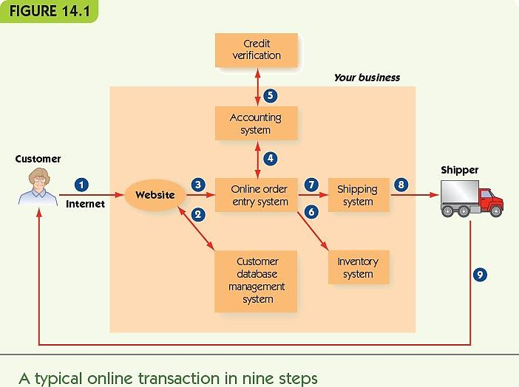
Ecommerce (5 of 16)

Slide 10
Ecommerce (6 of 16)
How do customers learn about your site?
  Conventional print advertising with URL
  An obvious domain name (home page URL)
    ICANN (Internet Corporation for Assigned Names and Numbers) registers domain names
  Search engine results (sponsored link)
  Presence on a portal (website about a topic) with links to retail, wholesale, and informational websites
Notes:
客户如何了解您的网站？
带有URL的常规平面广告
明显的域名（主页URL）
ICANN（互联网名称与数字地址分配机构）注册域名
搜索引擎结果（赞助商链接）
存在于门户网站（有关主题的网站）上，并带有指向零售，批发和信息网站的链接

Slide 11
Ecommerce (7 of 16)
Identify return customers and personalize the site
  Require the user to register and log in
    Connects to the database with the user’s past history on the site
  Leave a cookie on the user’s computer
    Small text file containing information about the user
    Allows continuity between one page of a site and another
    (Relatively) harmless
Notes:
识别回头客并个性化网站
要求用户注册并登录
使用用户过去在站点上的历史记录连接到数据库
将Cookie留在用户的计算机上
包含有关用户信息的小文本文件
允许站点的一页与另一页之间的连续性
（相对）无害

Slide 12
Ecommerce (8 of 16)
Provide a secure environment for making a purchase
  Encryption: ensure sensitive information is encrypted for transmission
  Authentication: verify that your website is legitimate
Notes:
提供安全的购物环境
加密：确保对敏感信息进行加密以进行传输
验证：确认您的网站合法

Slide 13
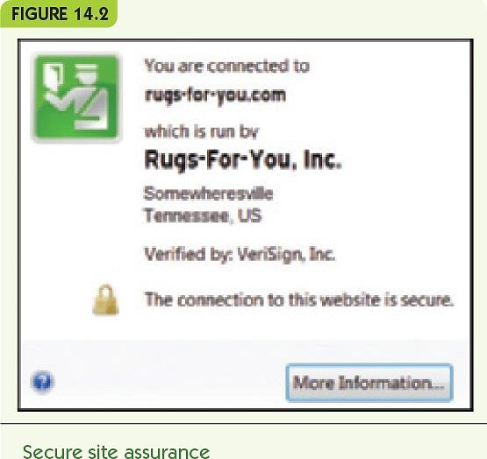
Ecommerce (9 of 16)

Slide 14
Ecommerce (10 of 16)
Process payment
  Option 1: while the customer waits
    Online form communicates with accounting software
    Accounting system verifies customer credit
    Customer can correct bad information
    No need to keep credit card numbers
  Option 2
    Record the order and payment information
    Verify and complete the transaction offline
    Send email confirmation to the customer
Notes:
处理付款
选项1：在客户等待时
在线表格与会计软件进行通信
会计系统验证客户信用
客户可以更正不良信息
无需保留信用卡号
选项2
记录订单和付款信息
脱机验证并完成交易
发送电子邮件确认给客户

Slide 15
Ecommerce (11 of 16)
Fulfill the order
  Communicate with online inventory
    Reduce item counts for purchased items
  Arrange for shipping
    Online shipping system
    External shipping company
  Arrange pick-up at the warehouse and delivery to the customer
Notes:
完成订单
与在线库存沟通
减少购买物品的数量
安排运输
在线运输系统
对外运输公司
安排在仓库的提货并交付给客户

Slide 16
Ecommerce (12 of 16)
Website design: overall
  Attractive with new products displayed
  Good design principles
  Organize for natural shopping habits
  Make it easy to navigate
    Provide site map or navigation bar
    No more than four clicks from one page to another
  Encourage browsing and targeted searching
  Ensure the site works on different platforms and browsers
Notes:
网站设计：整体
具有吸引力的新产品展示
好的设计原则
组织自然的购物习惯
轻松浏览
提供网站地图或导航栏
从一页到另一页的点击次数不超过四次
鼓励浏览和目标搜索
确保网站可以在不同的平台和浏览器上运行

Slide 17
Ecommerce (13 of 16)
Website design: purchase
  Provide electronic “shopping carts”
  Checkout steps that:
    Always show details of order
    Clearly indicate what the next button click does
    Allow the customer to go back and change things
    Give the customer shipping options
    Provide email with order information and shipping confirmation
Notes:
网站设计：购买
提供电子“购物车”
结帐步骤如下：
一律显示订单明细
清楚指出下一步按钮的作用
允许客户回去改变事物
给客户送货选择
提供包含订单信息和运输确认的电子邮件

Slide 18
Ecommerce (14 of 16)
Website design: other information
  FAQ page and link to customer service
  Entries allowed for customer reviews or forums
  News and press releases
  Links to your social media sites
Notes:
网站设计：其他信息
常见问题页面和链接到客户服务
允许客户评论或论坛的条目
新闻和新闻稿
链接到您的社交媒体网站

Slide 19
Ecommerce (15 of 16)
  Multiple software systems must communicate
    Website, accounting, inventory, and shipping
    Suppliers, orders, and billing
    Personnel
  Legacy code: existing old software still in use
  Middleware: software to enable separate systems to communicate
  Disaster recovery strategy: response to natural disasters, equipment failures, or being hacked
Notes:
多个软件系统必须进行通信
网站，会计，库存和运输
供应商，订单和账单
人员
旧版代码：仍在使用的旧软件
中间件：使单独的系统进行通信的软件
灾难恢复策略：应对自然灾害，设备故障或被黑客入侵

Slide 20
Ecommerce (16 of 16)
Other ecommerce models
  eBay: peer-to-peer auction-style sales
  Craigslist: peer-to-peer classified ads
  Groupon: group coupons
    Businesses post coupons for one day only
    Minimum number required
  PayPal: online payment service
  Apple Pay and similar system: mobile payment systems
  Bitcoin: virtual currency
Notes:
其他电子商务模式
eBay：点对点拍卖式销售
Craigslist：点对点分类广告
Groupon：团体优惠券
企业仅将优惠券发布一天
所需的最低人数
PayPal：在线支付服务
Apple Pay和类似系统：移动支付系统
比特币：虚拟货币

Slide 21
Databases (1 of 15)
Databases store large amounts of data
Businesses require databases for:
  Inventory, personnel, customers, suppliers, and financials
Data organization
  Bits and bytes: basic pieces of computer data
  Field: one meaningful piece of information
  Record: a set of related fields
  Data file: a set of related records
  Database: a set of related data files
Notes:
数据库存储大量数据
企业需要以下数据库：
库存，人员，客户，供应商和财务
资料组织
位和字节：计算机数据的基本部分
领域：一条有意义的信息
记录：一组相关字段
数据文件：一组相关记录
数据库：一组相关的数据文件

Slide 22
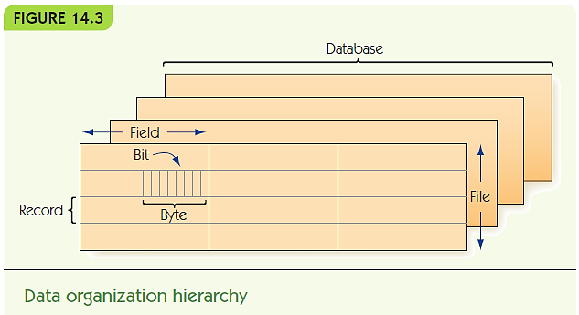
Databases (2 of 15)

Slide 23
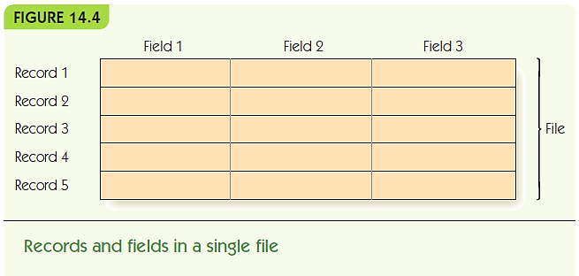
Databases (3 of 15)
Data files are represented as tables
  Records are rows; fields are columns

Slide 24
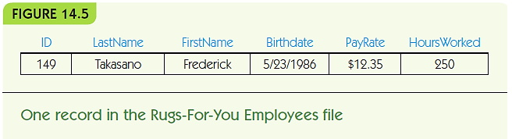
Databases (4 of 15)
Rugs-for-You: example of an employee record
  Record = one employee
  Each field has:
    A field name (a category) with a specific data type
    A value in the field for the selected record (employee)
Notes:
为您服务的地毯：员工记录的示例
记录=一名员工
每个字段都有：
具有特定数据类型的字段名称（类别）
所选记录（员工）的字段中的值

Slide 25
Databases (5 of 15)
Database management system (DBMS)
  Manages files in a database
Relational database model: files are 2-d tables
  Entity: a distinguishable component of system
    Example: an employee, a customer, or a rug for sale
  Tuple: a row of a relational table
  Attribute: category of a field
  Primary key: attribute(s) that uniquely identify a tuple
Another name for record
Notes:
数据库管理系统（DBMS）
管理数据库中的文件
关系数据库模型：文件是二维表
实体：系统的一个独特组成部分
例如：员工，客户或待售地毯
元组：关系表的一行
属性：字段类别
主键：唯一标识元组的属性

Slide 26
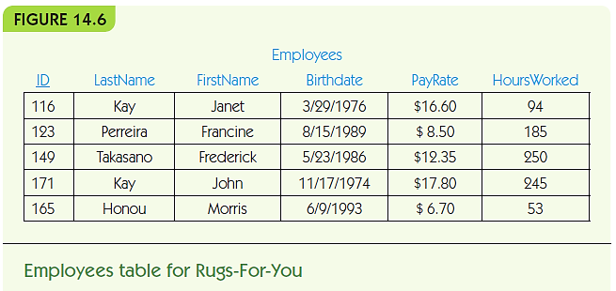
Databases (6 of 15)

Slide 27
Databases (7 of 15)
SQL (Structured Query Language)
  Standard query language for DBMS
  Use SQL queries to retrieve data according to some criteria
  Example 1: retrieve employee name, pay rate, and hours worked for employees named Perreira
Notes:
SQL（结构化查询语言）
DBMS的标准查询语言
使用SQL查询根据某些条件检索数据
示例1：检索名为Perreira的员工的员工姓名，工资率和工作时间

Slide 28
Databases (8 of 15)
SELECT ID, LastName, FirstName, Payrate, HoursWorked
FROM Employees
WHERE LastName = ‘Perreira’;
SELECT *
FROM Employees
ORDER BY ID;
SELECT *
FROM Employees
WHERE PayRate > 15.00

Slide 29
Databases (9 of 15)
  Example 2: retrieve all employee records, sorted by ID number
SELECT *
FROM Employees
ORDER BY ID;
  Example 3: retrieve records of employees who are paid more than $15.00 per hour
SELECT *
FROM Employees
WHERE PayRate > 15.00

Slide 30
Databases (10 of 15)
Multiple tables may contain related data
  Example: insurance policies for Rugs-for-You
Foreign key: an attribute in one table that is the key in another
  Connects data in one table with another
  Example: EmployeeID
Notes:
多个表可能包含相关数据
示例：“为您提供地毯”的保险单
外键：一个表中的一个属性，另一个表中的键
将一个表中的数据连接到另一个表
示例：EmployeeID

Slide 31
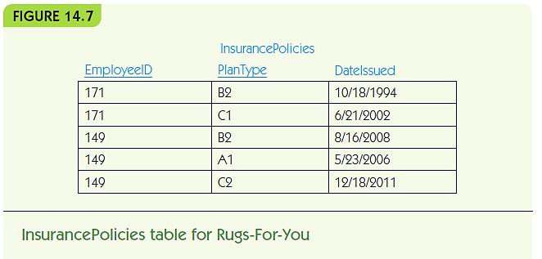
Databases (11 of 15)

Slide 32
Databases (12 of 15)
Multi-table example
SELECT LastName, FirstName, PlanType
FROM Employees, Insurance Policies
Where LastName = ‘Takasano’
AND FirstName = ‘Frederick’
AND ID = EmployeeID;

Slide 33
Databases (13 of 15)
Relational database operations
  Project: pick some attributes from a set of tuples
SELECT LastName, FirstName, PlanType
FROM Employees, Insurance Policies
  Restrict: pick tuples that meet criteria
WHERE LastName = ‘Takasano’
AND FirstName = ‘Frederick’
  Join: combine tuples from different tables
FROM Employees, Insurance Policies
…
AND ID = EmployeeID;
限制
联接
Notes:
关系数据库操作
项目：从一组元组中选择一些属性
选择姓氏，名字，计划类型
来自员工，保险单
限制：选择符合条件的元组
WHERE LastName =“高野”
AND FirstName =“弗雷德里克”
联接：合并来自不同表的元组
来自员工，保险单
…
AND ID =员工ID；

Slide 34
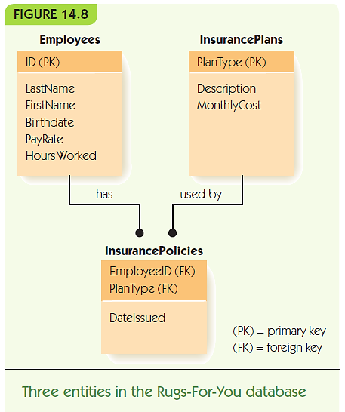
Databases (14 of 15)

Slide 35
Databases (15 of 15)
完整性
Database integrity: verification as data is added/removed
  Entity integrity: no primary key can be missing
  Data integrity: values must match category constraints (e.g., be a valid pay rate)
  Referential integrity: foreign keys must match a primary key value in the related table
Efficiency:
  Disk access is slow
  File management systems can organize disk files for faster access
Distributed database: data stored across a computer network
不会丢失任何主键
约束
分布式数据库
Notes:
数据库完整性：添加/删除数据时进行验证
实体完整性：不会丢失任何主键
数据完整性：值必须与类别约束相匹配（例如，为有效的工资率）
参照完整性：外键必须与相关表中的主键值匹配
效率：
磁盘访问缓慢
文件管理系统可以组织磁盘文件以加快访问速度
分布式数据库：跨计算机网络存储的数据

Slide 36
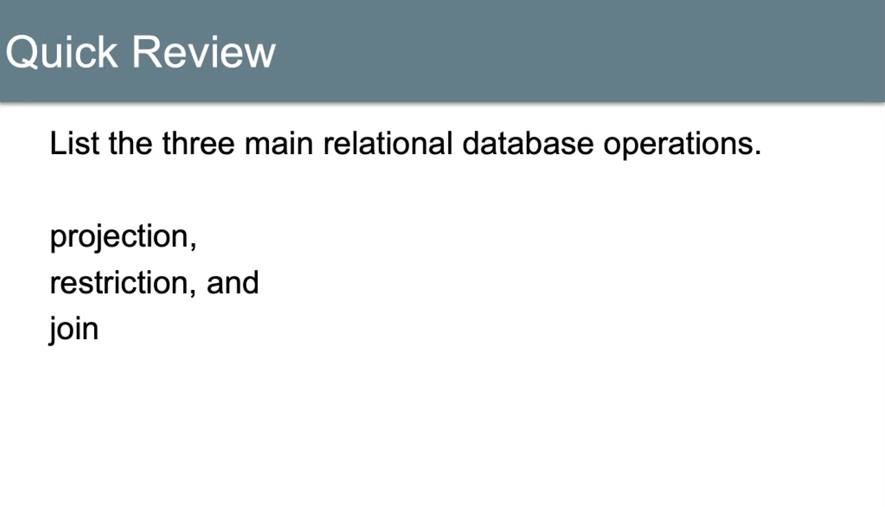

Slide 37
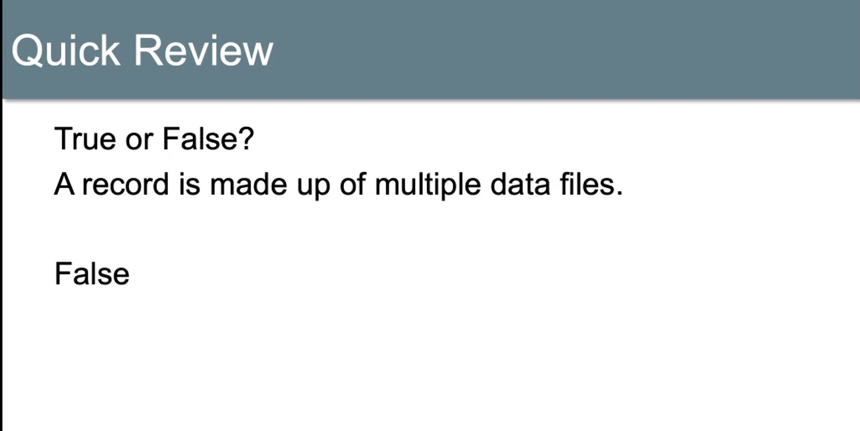

Slide 38
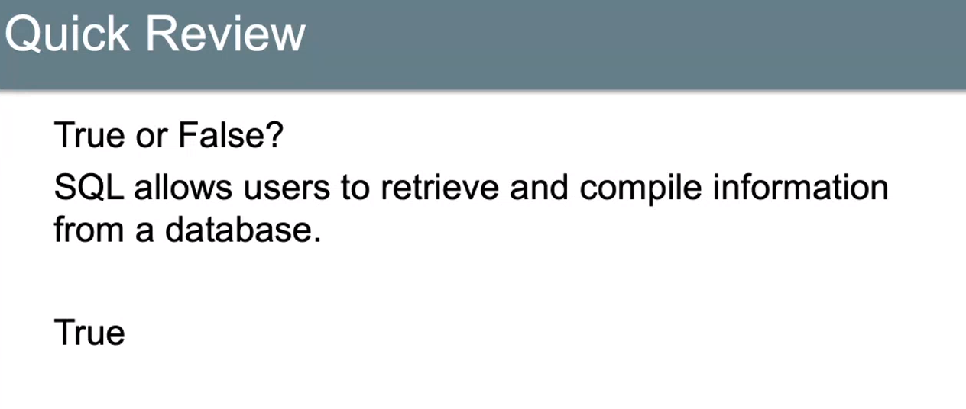

Slide 39
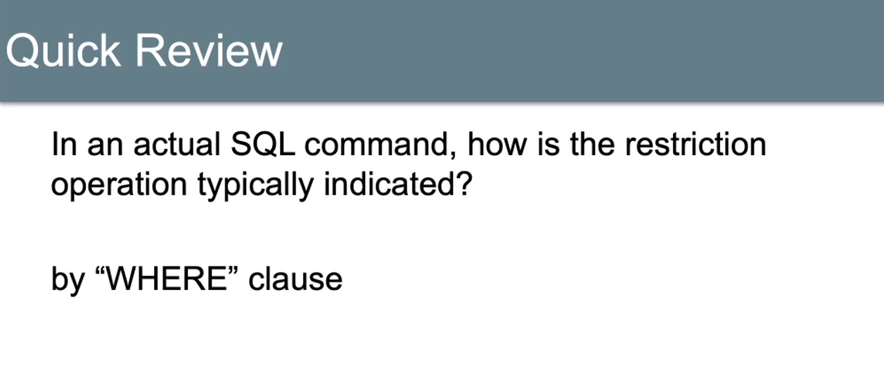

Slide 40
Data Science (1 of 5)
Big data: Huge amounts of available data
Data analysis: Process of finding the right data sets, putting data in the right format, and writing queries to extract information
Data science: Incorporates data analysis tasks, but requires knowledge of the enterprise for useful queries and the use of statistics and visualization techniques to interpret the results and predict future strategies to achieve a predetermined goal
Data warehouse: A collection of databases that contain current and archived data for research and analysis
Notes:
大数据：大量可用数据
数据分析：查找正确的数据集，以正确的格式放置数据以及编写查询以提取信息的过程
数据科学：包含数据分析任务，但需要企业知识以进行有用的查询，并需要使用统计数据和可视化技术来解释结果并预测实现预定目标的未来策略
数据仓库：包含当前和已归档数据以供研究和分析的数据库集合

Slide 41
Data Science (2 of 5)
Data mining: Process of analyzing data to extract and interpret previously hidden patterns through several steps:
  1. Determine the problem to be solved
  2. Review the condition of the data: Does all data have the same structure? Are any tuples missing information?
  3. Determine a model that will help bring out the patterns: Patterns classify the data to determine the strongest predictors of a given outcome – this is the data mining part: creation of a model
  4. Evaluate your model: Are the results predicted borne out by further data? Would a different model give better results?
Notes:
数据挖掘：分析数据以通过以下几个步骤提取和解释先前隐藏的模式的过程：
1.确定要解决的问题
2.检查数据的状况：所有数据都具有相同的结构吗？ 元组是否缺少信息？
3.确定一个有助于弄清楚模式的模型：模式对数据进行分类，以确定给定结果的最强预测因子–这是数据挖掘部分：模型的创建
4.评估您的模型：进一步的数据是否证明了预测结果？ 不同的模型会带来更好的结果吗？

Slide 42
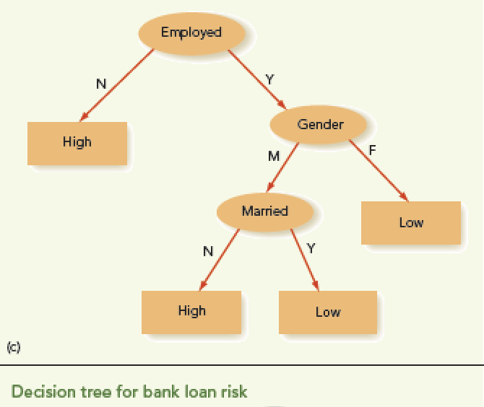
Data Science (3 of 5)
Decision Tree
  One type of model
Easy to convert to an algorithm
  Is the model too simplistic?
  Is the resulting algorithm biased?
Notes:
决策树
一种模型
易于转换为算法
模型太简单了吗？
结果算法有偏差吗？

Slide 43
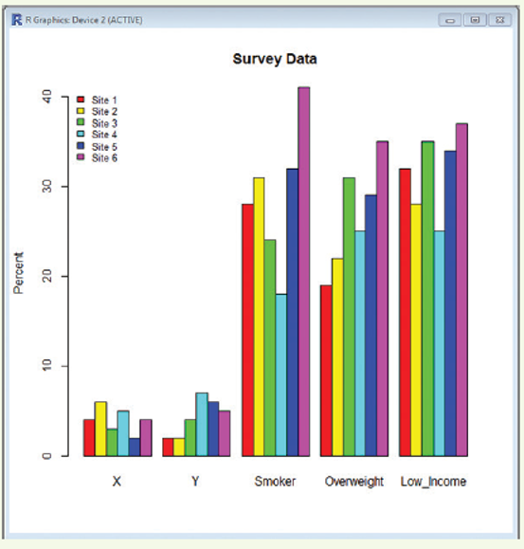
Data Science (4 of 5)
Other Data Science Tools
  Statistical analysis
  Graphical visualization
  Language R can help with both these tasks
Notes:
其他数据科学工具
统计分析
图形可视化
语言R可以帮助完成这两项任务

Slide 44
Data Science (5 of 5)
Privacy issues associated with data mining
Automatically analyzing large amounts of data to uncover hidden patterns
Data brokers: companies that collect and sell data such as:
  Birth certificates, marriage certificates, publically available information, and nonpublic data purchased or acquired from other companies or data brokers.
Nontheless, data science can make contributions to
  Medicine, science, ecology, and many more fields
Notes:
与数据挖掘相关的隐私问题
自动分析大量数据以发现隐藏的模式
数据经纪人：收集和出售数据的公司，例如：
从其他公司或数据经纪人处购买或获取的出生证明，结婚证明，公开信息以及非公开数据。
但是，数据科学可以为
医学，科学，生态学以及更多领域

Slide 45
Summary (1 of 2)
Ecommerce is a central part of our economy
Businesses deciding to enter the online world must plan carefully
Ecommerce web design is complicated
Ecommerce requires integrating multiple computer systems: inventory, accounting, suppliers, etc.
Databases are systems to store large amounts of data
Data is organized into fields, records, data files, and databases
Notes:
电子商务是我们经济的核心部分
决定进入在线世界的企业必须仔细计划
电子商务网站设计很复杂
电子商务需要集成多个计算机系统：库存，会计，供应商等。
数据库是用于存储大量数据的系统
数据被组织成字段，记录，数据文件和数据库

Slide 46
Summary (2 of 2)
DBMS manages files of databases
The relational database model is the most common: records represent entities; all data is viewed as sets of 2-d tables
SQL is the most common query language for retrieving data from a DBMS
Databases must ensure integrity, efficiency, and (sometimes) distributed access to data
Data mining discovers hidden patterns in a big data set
Privacy issues arise due to data mining techniques
Notes:
DBMS管理数据库文件
关系数据库模型是最常见的：记录代表实体； 所有数据都被视为二维表的集合
SQL是从DBMS检索数据的最常见查询语言
数据库必须确保完整性，效率和（有时）对数据的分布式访问
数据挖掘发现大数据集中的隐藏模式
隐私问题归因于数据挖掘技术

